Slide 1
Introduction to Flexibility and Stretching

Slide 2
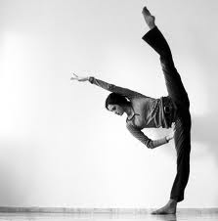
Overview
The role of flexibility
Biomechanical advantage
Structures involved
Changes over time
  Age-related
  Training related
Measuring flexibility - lab

Slide 3
Flexibility
“To bend or be pliable” (Alter, 2004)
Definition: ‘the ability of the neuromuscular system to allow for efficient movement of a joint or series of joints through full, non-restricted, pain free range of motion’ (Prentice, 2004)
Allows movement
  Not always large ranges of movement, sometimes mechanical advantage
  What movements do you NEED flexibility for
Notes:
Sport related norms

Slide 4
Biomechanical Advantage
Mechanical advantage - The ratio of the output force produced by a machine to the applied input force
Relate this to “Bio-”
  Essentially what you gain from using a machine
  Therefore in bio terms, what you gain from using your body differently or altering position

Slide 5
Biomechanical Advantage
flexibility = biomechanical advantage
Positional change (assuming plastic deformation)
Force production change
  Chapter 4
  More sarcomeres therefore more force produced
  However, research has recently shown increased length DECREASES force production
Efficiency / aesthetical result

Slide 6
Injury
Tight muscles are more likely to tear
  Relate to stress-strain curve
  More compliant = less susceptible
Excessive ROM is often not necessary in sport
  Problems associated with it
  Injuries often occur during flexibility training sessions
  Overstretching - relate to stress-strain curve

Slide 7
Restrictions
What restricts?
  Muscle length
  Muscle connective tissue (endo-, peri-, epi-)
  Muscle strength (if active)
  Bone
  Scar tissue
  Joint structures – position and capsule
  Neural structures
  Overactive receptors leading to increased muscle tone
What can we change?
Plastic deformation of collagen
Genes (Collagen)
  Can be changed through stretching
  Sadoshima and Izumo (1993)

Slide 8
Muscle
Parallel Elastic Component (PEC) responsible for resting length/tension lies alongside contractile component
  Sarcolemma, sarcoplasm, epi, peri and endomysium and Titin
  Titin thought to be responsible for elasticity
Series Elastic Component (SEC)
  “smoothing out rapid changes” (Alter, 2004) - mediator
  Passive – Primarily tendon
  Active – Cross bridges between actin and myosin
Contractile Component (CC)
  The filaments

Slide 9
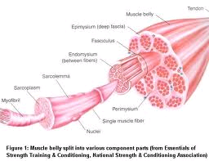
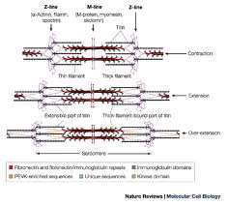

Slide 10
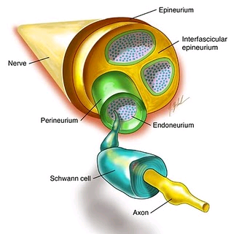
Nerve
Elastic range 6-20% of resting length
As with any tissue will fail under excessive loading
Nerves need to slide in their sheaths
  3 sheaths – epi, peri and endoneurium
Restriction of this causes ‘Adverse Neural Tension’

Slide 11
What can we change?
Remember there are acute and chronic effects
Muscular
  Plastic deformation – new resting length
  Creep – constant length held leads to lengthening
  Stress-relaxation – constant length held leads to relaxation
Neural
  Decreased reflexes
    acute i.e. autogenic inhibition – GTO overriding muscle spindles
    Decreased Hoffmann reflex (H-reflex)
  Spinal cord plasticity (CNS)
    Spinal cord can be altered through reflexes and learned behaviour
    Reducing the stretch reflex should allow muscle to stretch further

Slide 12
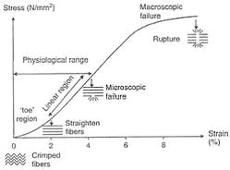
Stress-Strain curve
Soft tissues can be altered
  Stress strain relationship
  The stiffer the structure the more force needed to elongate it
  Should we stretch at end of elastic or into plastic range?

Slide 13
What can we change?
Bony changes are not likely after age 11 (Bennell and Khan, 2001)
Maximal flexibility at age 10-11 then slowly decreasing (Valdivia, 2008)
Milne and Mierau (1979) related school sitting position to tight hamstrings
Reflexes associated with flexibility were decreased in dancers (Nielsen et al., 1993)
  Caused by “prolonged co-contraction during ballet positions”
Change in composition leading to a tendency to stay in a prolonged state
Modified titin within the muscle fibres
Modified myosin chain
Increased compliance and decreased cross-bridges

Slide 14
Age related changes
During growth spurts bones grow quicker than muscle
  Increased tension leads to decreased flexibility
  Adolescence
  Tension causes new sarcomeres
Muscle changes
  As we age our muscle atrophy
  Replaced by fatty and fibrous tissue leading to stiffness
  Decrease in muscle length with age (Gajdosik, 1997 in Alter, 2004)
Collagen changes
  Increases rigidity by various methods – Alter (2004, p.41)

Slide 15
Recommended Reading
Alter, M.J. (2004) Science of Flexibility, Human Kinetics; Champaign, IL, pp.277-8

